Slide 1



GAMING AND
MENTAL HEALTH
DEPI Data Analysis Track | Graduation Project

Slide 2





The Outlier Team
Mohamed Bedier
Youssef Talaat
Shahd Mohamed
Belal Ahmed
Ibrahim Elnemr

Slide 3
Agenda
1.Introduction
2 . Motivation
3.Excel
4.SQLl
5.Python
6.Tableau
7.Power BI

Slide 4


Introduction

Slide 5

Project Overview
This study explores how gaming habits influence key mental health indicators among players. By analyzing behavioral and psychological data, we aim to uncover patterns that connect screen time, sleep, productivity, and social well-being.
● Identify correlations between gaming hours and mental health scores
● Categorize behavior patterns by addiction level and mood state
● Inform data-driven recommendations for healthier gaming habits

Slide 6
Project Motivation
Why did we choose this project?
Gaming is growing rapidly worldwide.
Mental health has become an important topic.
Understand how gaming behavior affects well-being.
Apply data analysis techniques to solve a real-world problem.
Build dashboards that provide meaningful insights.

Slide 7
Data Quality Challenges
Missing Values in two key columns:grades_gpa: 246 missing (24.6%)
work_productivity_score: 326 missing (32.6%)
Cause — Structural Missingness (age-related, not random):Ages 23+ (graduates/working adults) → no GPA, since they're no longer students
Ages under 19 (students/teens) → no productivity score, since they haven't entered the workforce
0 records have both fields missing — confirming the pattern is systematic, not random
Impact on Analysis:Treat both columns as indicators for two distinct sub-groups, not one unified metric
Combining them (e.g., overall average) without handling missingness properly would produce misleading results

Slide 8



Dataset Description
🕹 Daily Gaming Hours
🌙 Sleep Hours
🎓 GPA
📊 Productivity Score
😊 Mood State
🏃 Exercise Hours
🔒 Social Isolation Score
💸 Monthly Spending
📅 Years Gaming
💰 Total Spent

Slide 9
Data Pipeline
Excel → SQL
Python
Tableau → Power BI
Raw data imported and cleaned in Excel. Fact & Dimension tables structured. Data exported and loaded into SQL Server for schema design and relational querying.
Data preprocessed using Pandas. Feature engineering applied: Gaming_Hours_Category, Sleep_State, Spend_Category, Total_Spent. Visualizations generated for correlation analysis.
Interactive dashboards built in Tableau with slicers and drill-downs. Power BI KPI cards and filters applied for final analytical reporting and insights delivery.

Slide 10
Motivation

Slide 11
The motivation
behind this project is the increasing popularity of video games and the growing importance of mental health in today's society. By applying data analysis techniques, we aim to understand how different gaming habits relate to mental health indicators and present the findings through interactive dashboards that simplify data interpretation.

Slide 12
Excel

Slide 13
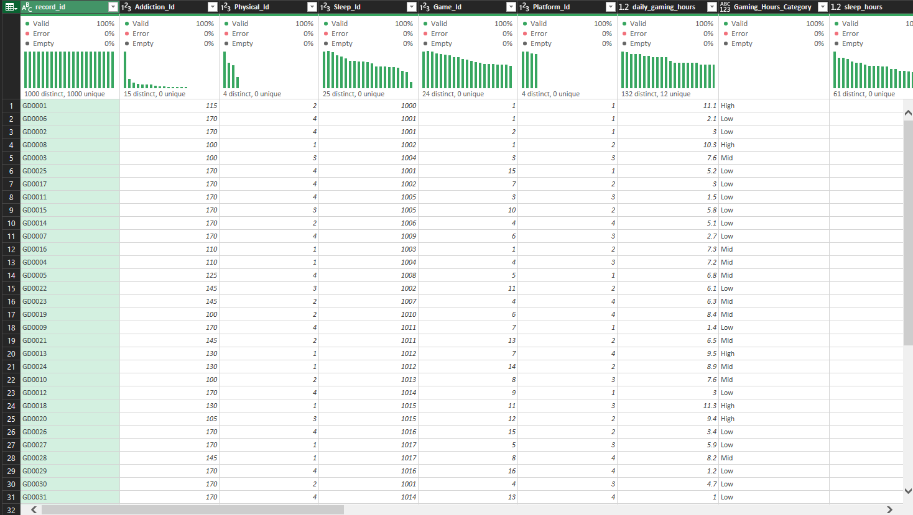

Excel Work
Data Cleaning & Preparation: Ensured 0% error and 0% empty values across all key fields before analysis began.
Feature Engineering: Built statistically-driven categories (Spend_Category, Gaming_Hours_Category) and composite risk indicators (Physical_Pain) using Power Query.
Data Modeling: Structured a Star Schema with one fact table and six dimension tables to enable fast, connected filtering.
Dashboarding: Delivered three interactive modules — Player, Addiction, and HealthCare — fully synchronized via slicers.

Slide 14
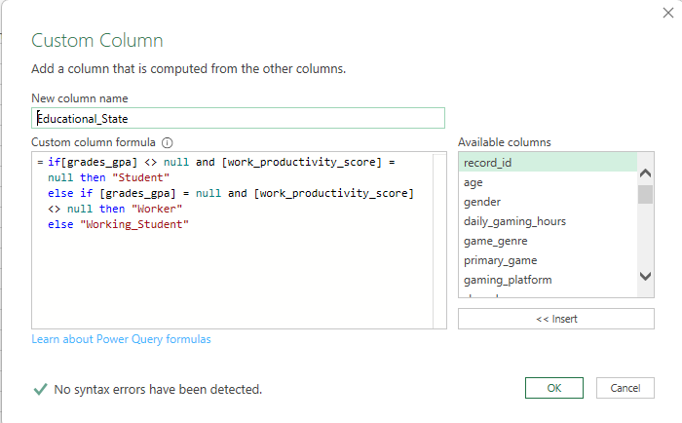
Excel Work
Feature Engineering:
Feature Engineering & Data Transformation:
created a new column that categorizes players into "Student," "Worker," or "Working_Student" based on their GPA and productivity scores to better understand player demographics.

Slide 15
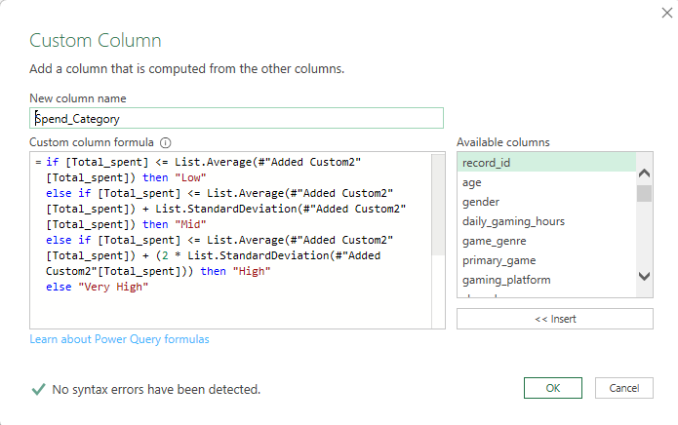
Excel Work
Feature Engineering:
Feature Engineering & Data Transformation:
Segmented players into spending tiers (Low, Mid, High, Very High) using statistical measures like Average and Standard Deviation to identify high-value segments.

Slide 16
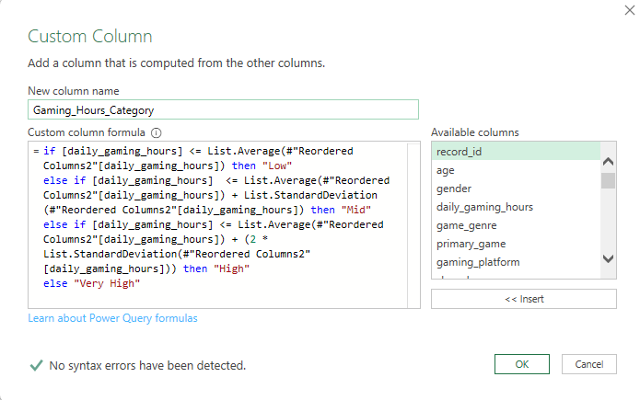
Excel Work
Feature Engineering & Data Transformation:
Categorized players based on daily gaming duration intensity, allowing for deeper analysis of gaming habits and potential addiction risks.

Slide 17
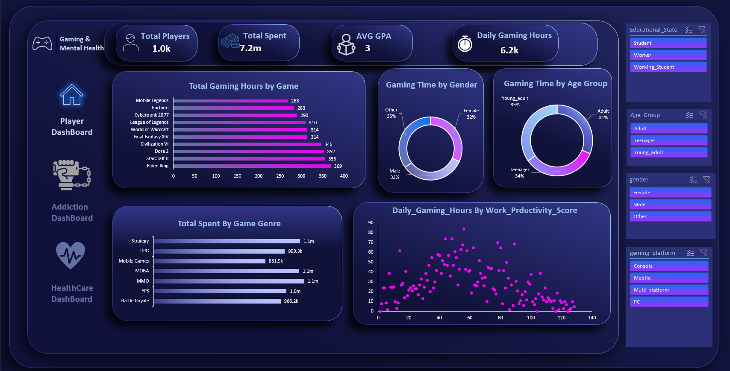
Dashboard Using Excel
Player Dashboard — Who plays, what they play, and what it costs
Demographics, game preferences, spending by genre, and the gaming-hours-vs-productivity relationship.

Slide 18
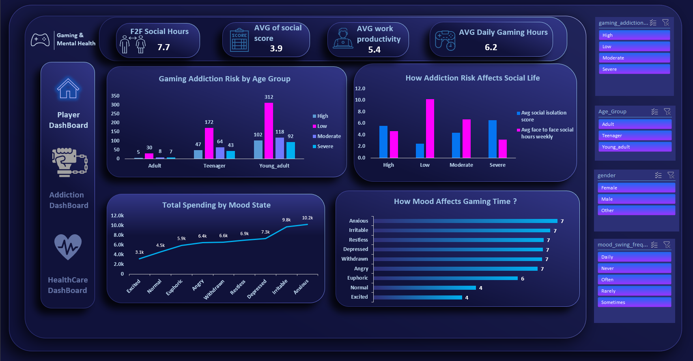
Dashboard Using Excel
Addiction Dashboard — How gaming risk affects mood, money, and social life
Addiction risk by age group, spending by mood state, and its impact on face-to-face interaction.

Slide 19
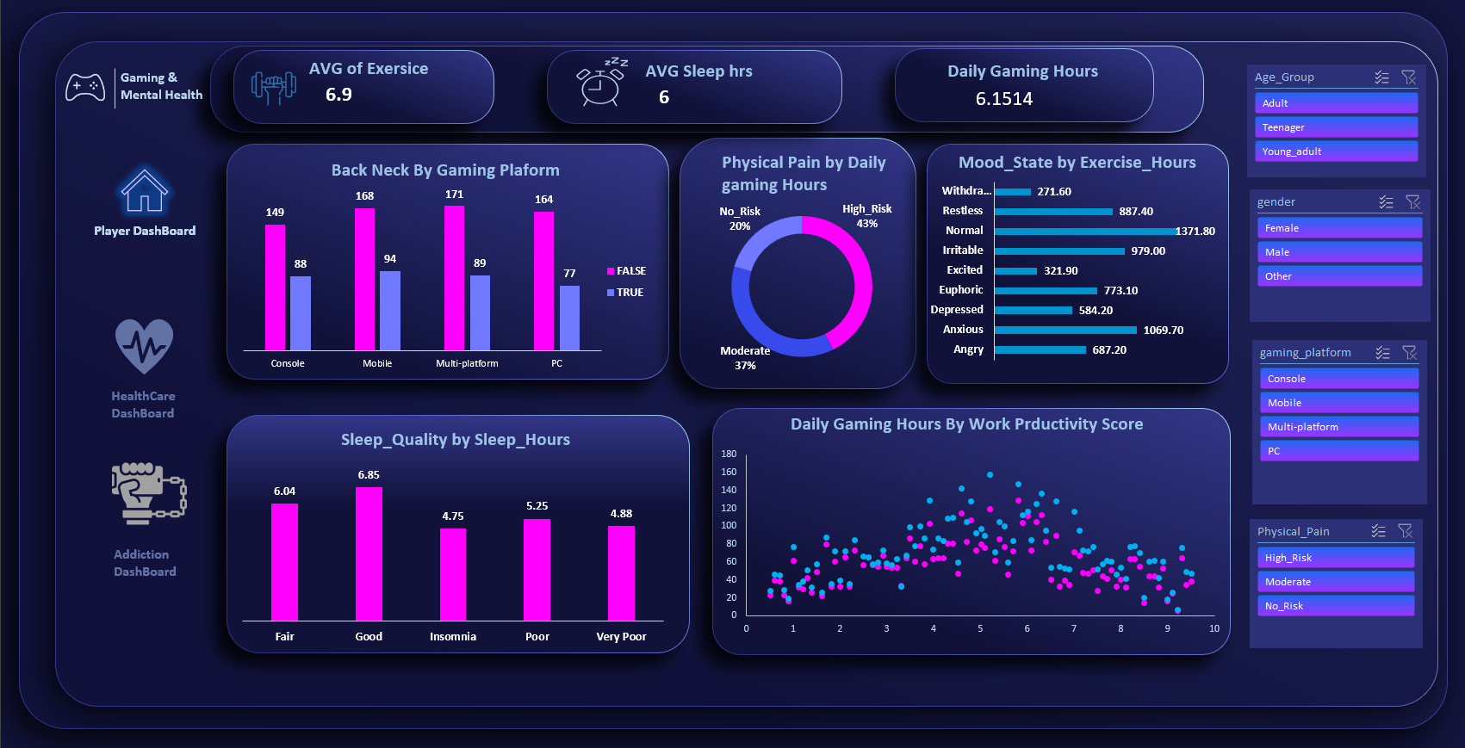
Dashboard Using Excel
HealthCare Dashboard — The physical cost of gaming habits
Sleep quality, exercise levels, and physical pain risk linked to daily gaming hours.

Slide 20
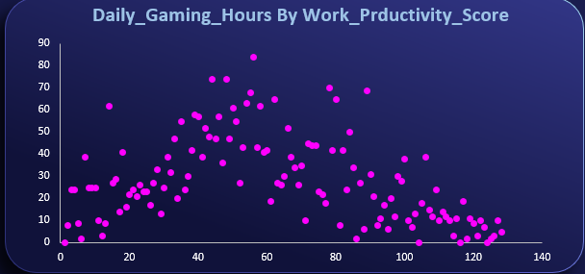
Excel Insights
Productivity does not decline steadily as gaming hours increase. Instead, it rises through the mid-range of gaming hours before tapering off at both extremes — contradicting the simple assumption that "more gaming always means lower productivity."

Slide 21
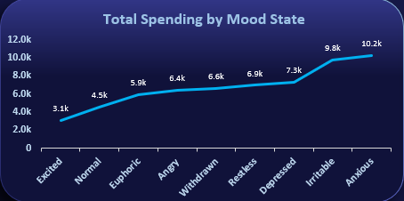
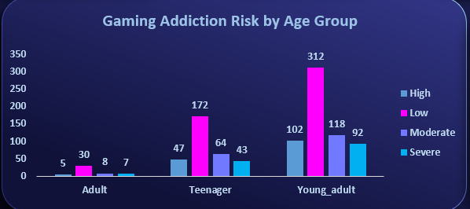
Excel Insights
Spending rises sharply as mood shifts from positive to negative states. Players in an "Anxious" state spend up to 10.2k — more than three times what players in an "Excited" state spend (3.1k) — suggesting mood is a significant driver of monetization.
Young adults report the highest counts across every addiction-risk level, most notably in the Low-risk category (312 cases) — far exceeding both Teenagers and Adults. This identifies young adulthood as the life stage requiring the most attention in awareness efforts.

Slide 22
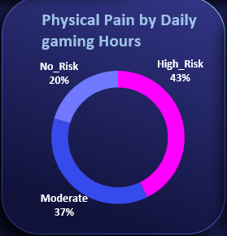
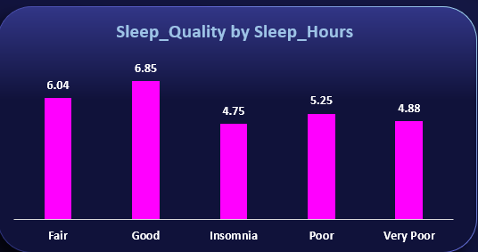
Excel Insights
Only 20% of players fall into the "No Risk" category for physical pain. The remaining 80% report at least Moderate discomfort, with 43% classified as High Risk — indicating that physical strain affects the large majority of engaged players.
Players classified as "Good" sleepers average 6.85 hours of sleep, while those labeled "Insomnia" or "Very Poor" average under 5 hours (4.75 and 4.88 respectively). This confirms the sleep-quality categories are grounded in real behavioral data, not arbitrary labels.

Slide 23
SQL

Slide 24
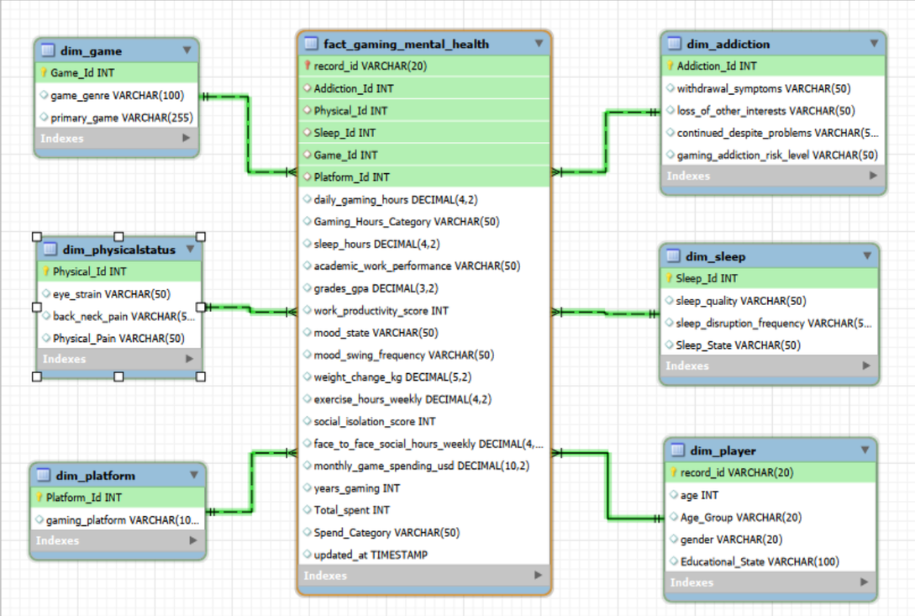

SQL Work
Database creation and schema design
Data cleaning & handling missing values
Establishing relationships between tables
Preparing analytical tables for querying
Structured querying for insights

Slide 25
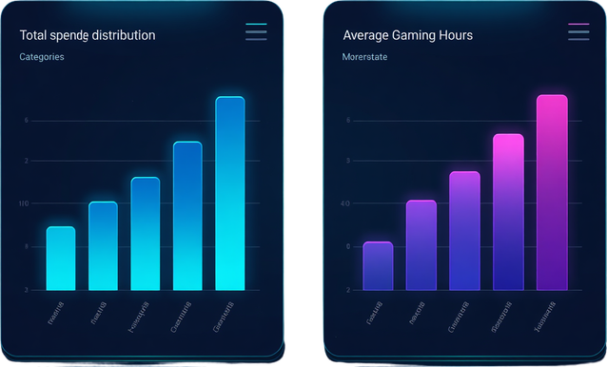
Does Age Really Drive Gaming Addiction?
1. Which age group plays the most?
Takeaway: Daily gaming hours — not age — is the real predictor of addiction risk.
Young Adults log the highest total hours (63% of all gaming hours) — but that's simply because they're the largest group in the sample.
2. Does that hold up per player?
Average hours per player are nearly identical across ages (Young Adults 6.22 vs Teenagers 6.12) — age barely moves the needle.
3. Does age affect grades?
GPA is almost the same across age groups (2.56 vs 2.49) — age isn't the real driver of academic impact.

Slide 26

What Actually Drives Addiction Risk?
Takeaway: Age is not the risk factor. Something else is.
1. Do daily gaming hours predict risk level?
Low-hour players are 89% "Low risk" with zero Severe cases — High/Very High-hour players flip to 51–61% Severe risk.
2. Does higher risk mean less sleep?
Severe-risk players average 4.6 hrs of sleep vs 6.6 hrs for Low-risk — a 2-hour gap.
3. Does addiction isolate players socially?
Severe-risk players report 6.5 isolation score and only 3.2 hrs of face-to-face time weekly, vs 2.5 / 10.2 hrs for Low-risk.

Slide 27
The Real-World Cost — Sleep, Body & Performance
1. How much sleep is lost?
Players above "Low" gaming hours lose ~2 full hours of sleep (6.69 hrs → 4.5–4.8 hrs).
2. What about physical health?
High-risk physical pain players game more than double the hours of pain-free players (8.3 vs 3.9 hrs/day).
Takeaway: More hours → less sleep → more physical pain → worse performance. One connected chain of cause and effect.
3. What's the impact on grades/work performance?
A clear inverse relationship: "Failing" performers average 8.52 hrs/day, "Excellent" performers average just 3.94 hrs/day.

Slide 28
Python

Slide 29

Python Work
Data preprocessing with Pandas (cleaning, formatting)
Feature engineering: Gaming_Hours_Category
Feature engineering: Sleep_State & Spend_Category
Deriving Total_Spent for spending analysis

Slide 30
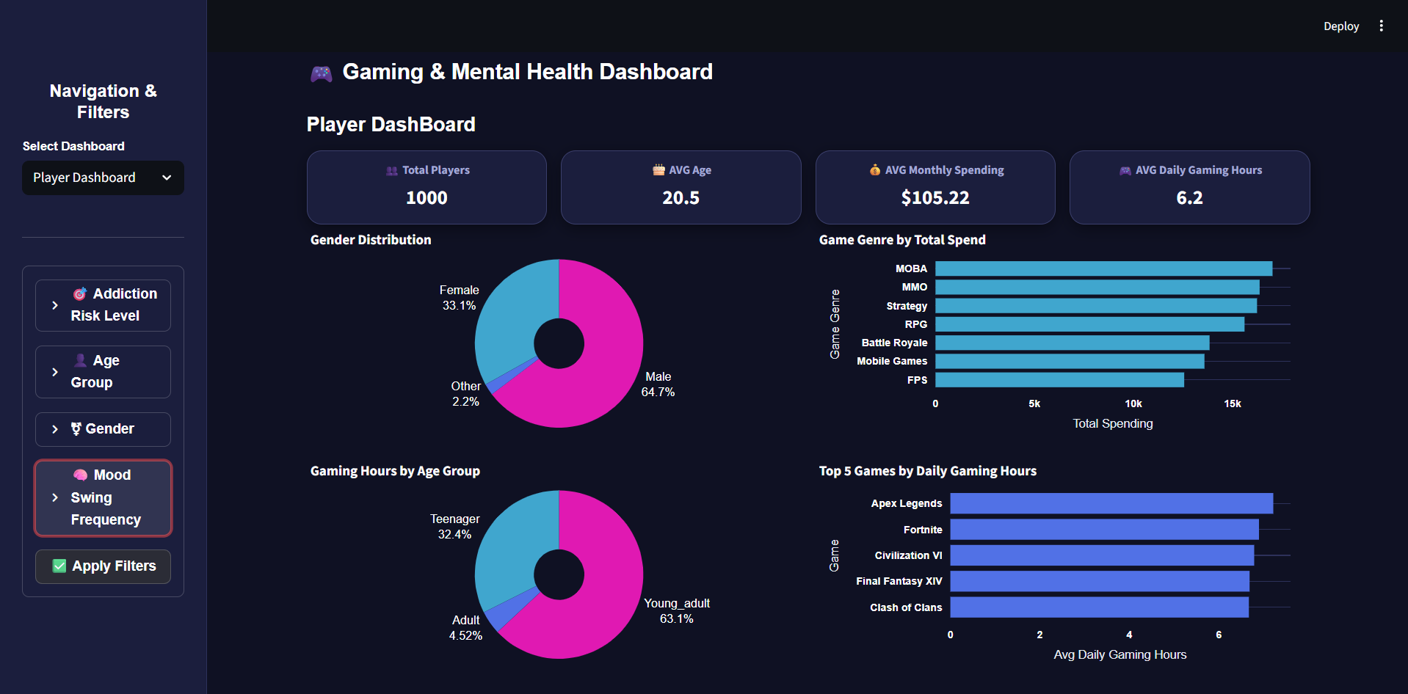

Slide 31
Python Insights
Financials & Academics: A community of 1.0k players generated a massive $7.2M in total spending. Despite a high average of 6.2 daily gaming hours, the Average GPA remains stable at 3.
Demographics: The audience is heavily male-dominated (66%) compared to female (32%), with playtime almost equally split across age groups (Young Adults 35%, Teenagers 34%, Adults 31%).
Games & Spending: Elden Ring leads in total playtime, while Strategy, MMO, and MOBA genres drive the highest revenue, each approaching the $1M spending mark.
Productivity Impact: The scatter plot indicates no direct negative correlation between long gaming hours and work productivity; many high-hour gamers still maintain peak productivity scores.

Slide 32
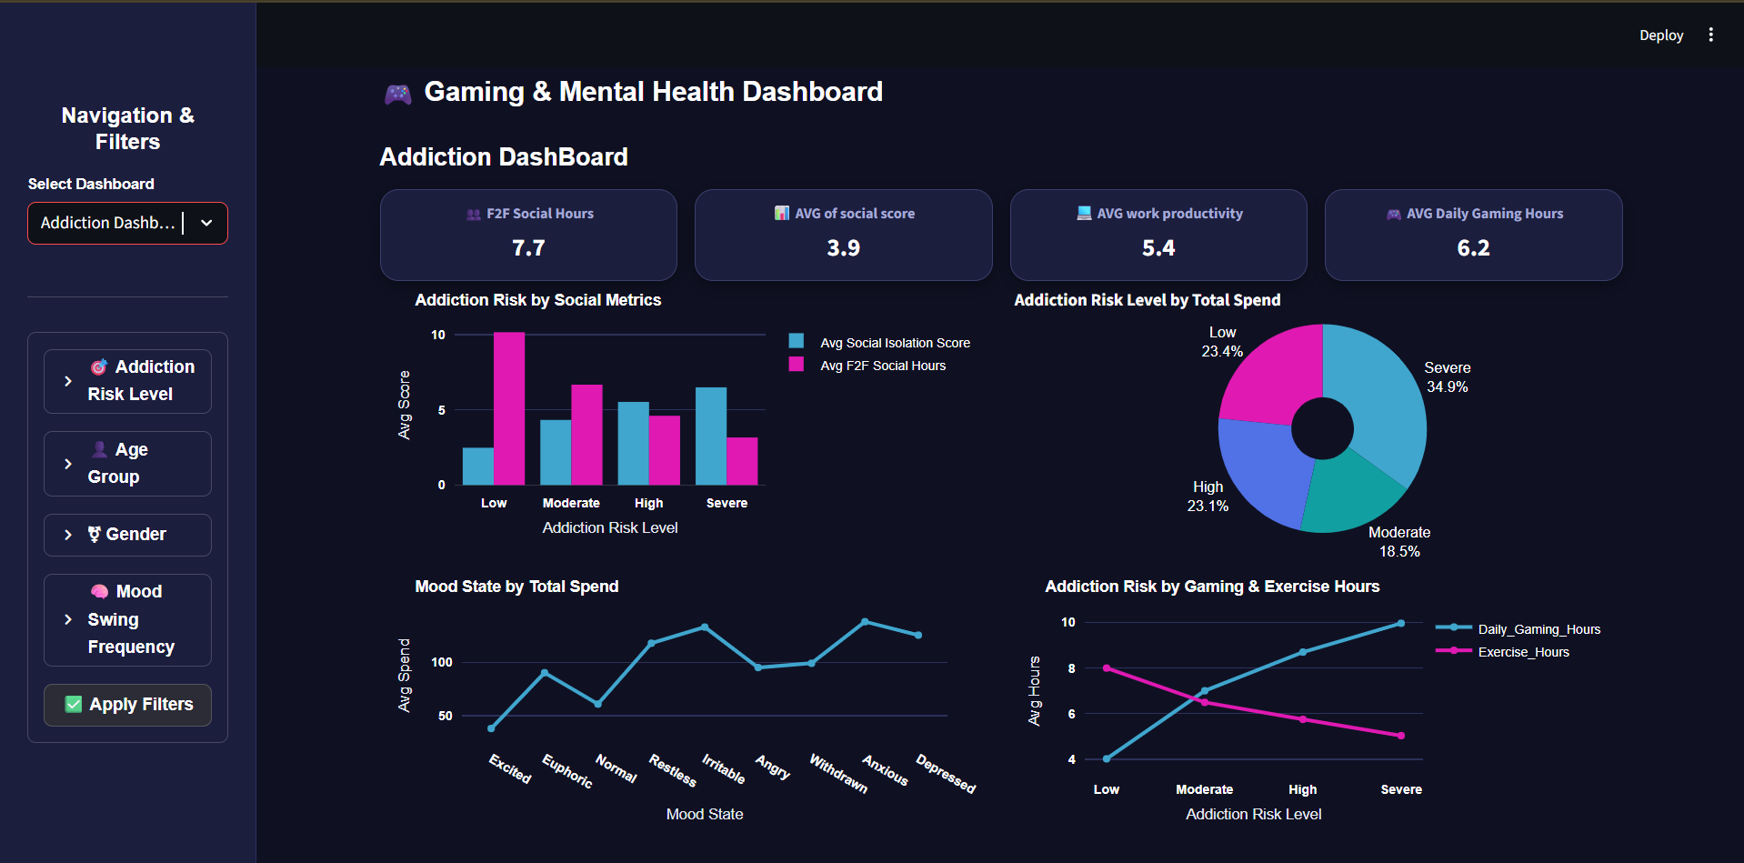

Slide 33
Python Insights
Health Baselines: Tracked players average 6.9 hours of exercise and 6 hours of sleep against a high baseline of 6.15 daily gaming hours.
Physical Pain & Platforms: A striking 43% of players are at "High Risk" for physical pain, with 37% at "Moderate Risk." Back and neck pain (TRUE status) is heavily prevalent across all platforms, peaking noticeably among Mobile and Multi-platform users.
Sleep Quality Impact: Sleep duration directly correlates with quality; players reporting "Good" sleep get the most rest (6.35 hours), while those with "Insomnia" or "Very Poor" sleep drop significantly (~4.38 to 4.75 hours).
Mood & Well-being: While a stable "Normal" mood state has the highest overall count (~1.4k), negative emotional states like Anxious (~1.1k) and Irritable (~970) still represent very high volume segments among the surveyed players.

Slide 34
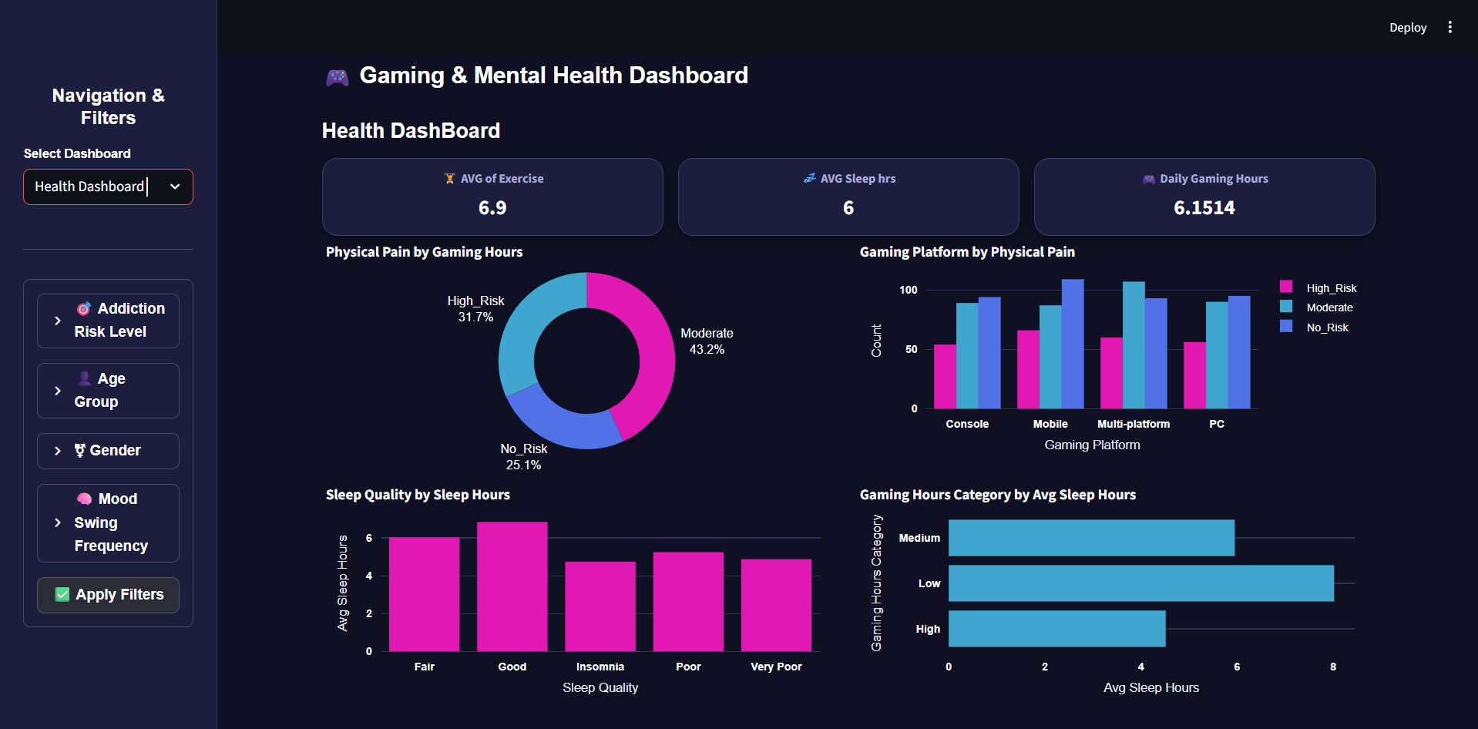

Slide 35
Python Insights
Social & Behavioral Baselines: Players average 7.7 weekly face-to-face (F2F) social hours and a 3.9 social score, alongside 5.4 work productivity against a high 6.2 daily gaming hours baseline.
Addiction vs. Social Life: There is a direct negative impact on socialization; High and Severe risk players suffer from elevated Social Isolation Scores and lower F2F social hours. In contrast, Low-risk individuals maintain peak weekly F2F social hours (~10 hours).
Demographic Vulnerability: Young Adults are significantly the most vulnerable group, dominating the risk distributions and peaking heavily in the "Low" to "Moderate" counts while holding a massive portion of the higher risk tiers.
Mood-Driven Spending & Playtime: Negative emotional states trigger extreme behavioral changes. Total financial spending spikes dramatically for Anxious, Irritable, and Depressed players. Furthermore, players in negative mood states average 7 daily gaming hours, compared to just 4 hours for Excited or Normal players.

Slide 36

Try Our Python Dashboard

Slide 37
Tableau

Slide 38
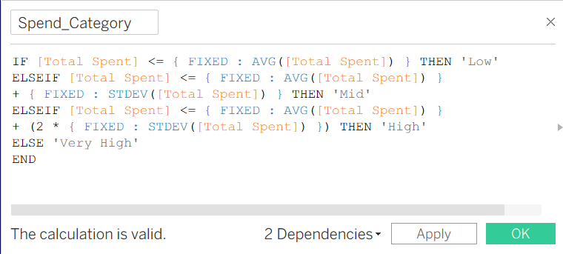
Tableau Work
created a Tableau calculated field using the average and standard deviation to classify players into Low, Mid, High, and Very High spending categories. This helped us analyze spending behavior more effectively.

Slide 39
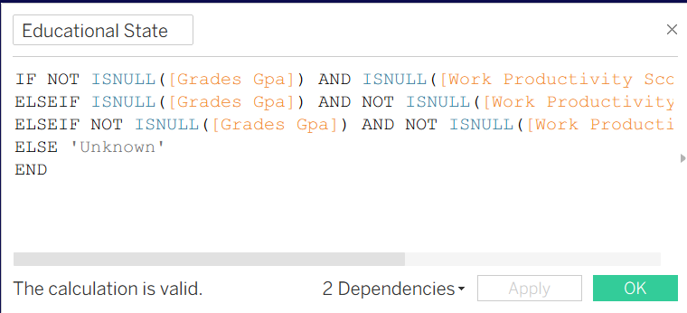
Tableau Work
created an Educational State calculated field in Tableau to categorize players into Student, Worker, or Working Student based on GPA and productivity data. This made it easier to analyze behavior across different groups.

Slide 40
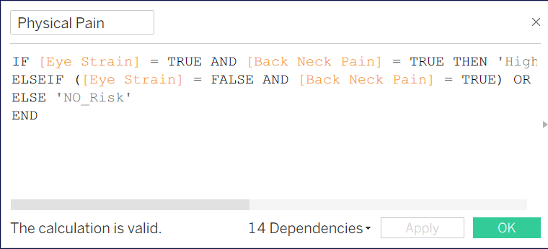
Tableau Work
created a Physical Pain calculated field that combines eye strain and back or neck pain to classify players into High Risk, Moderate Risk, or No Risk groups.

Slide 41
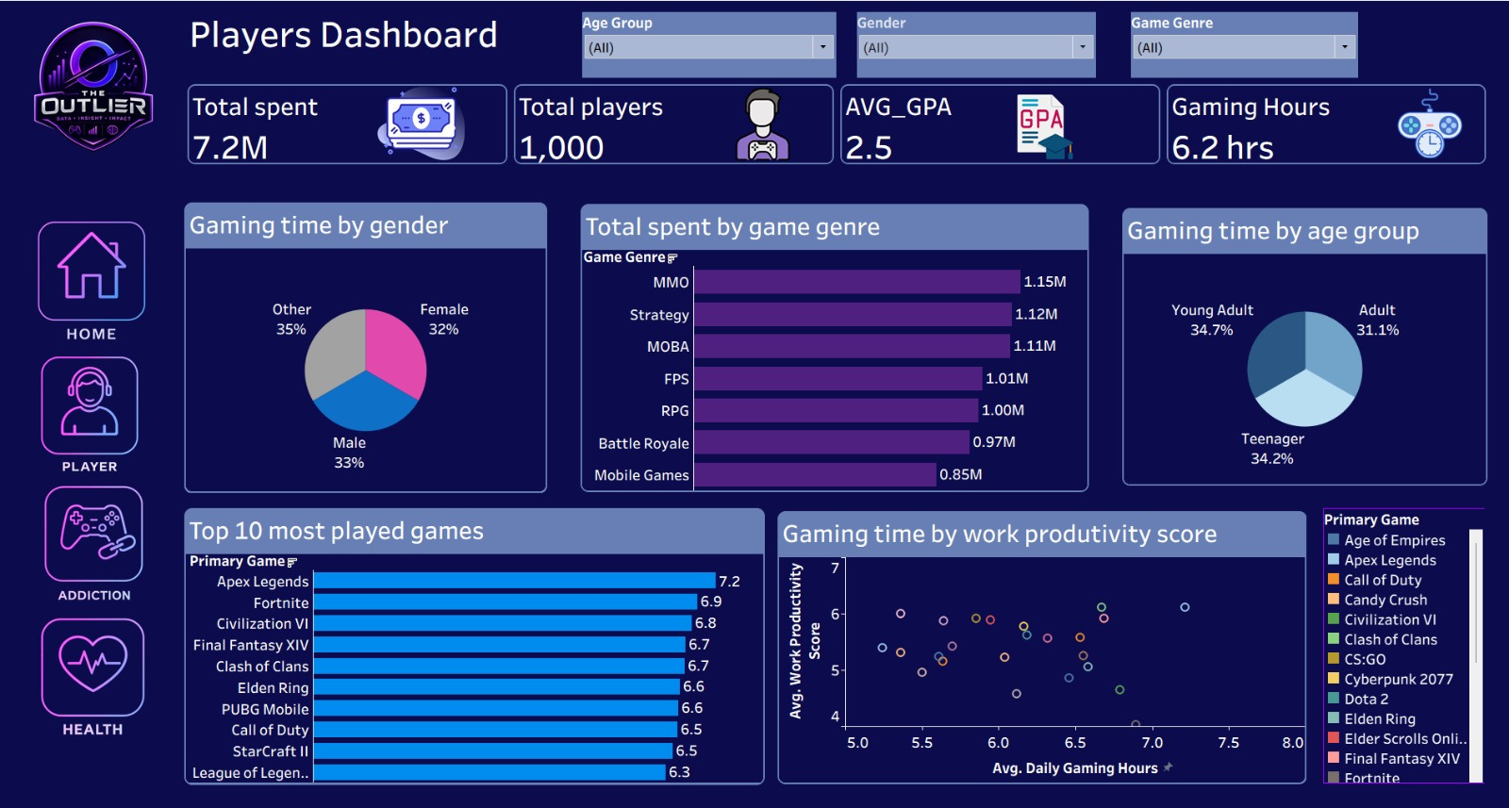

Tableau Dashboard
This dashboard provides an overview of player demographics, gaming behavior, and spending patterns. It analyzes player distribution by age and gender, identifies the most played games and genres, and examines the relationship between gaming hours and productivity.

Slide 42
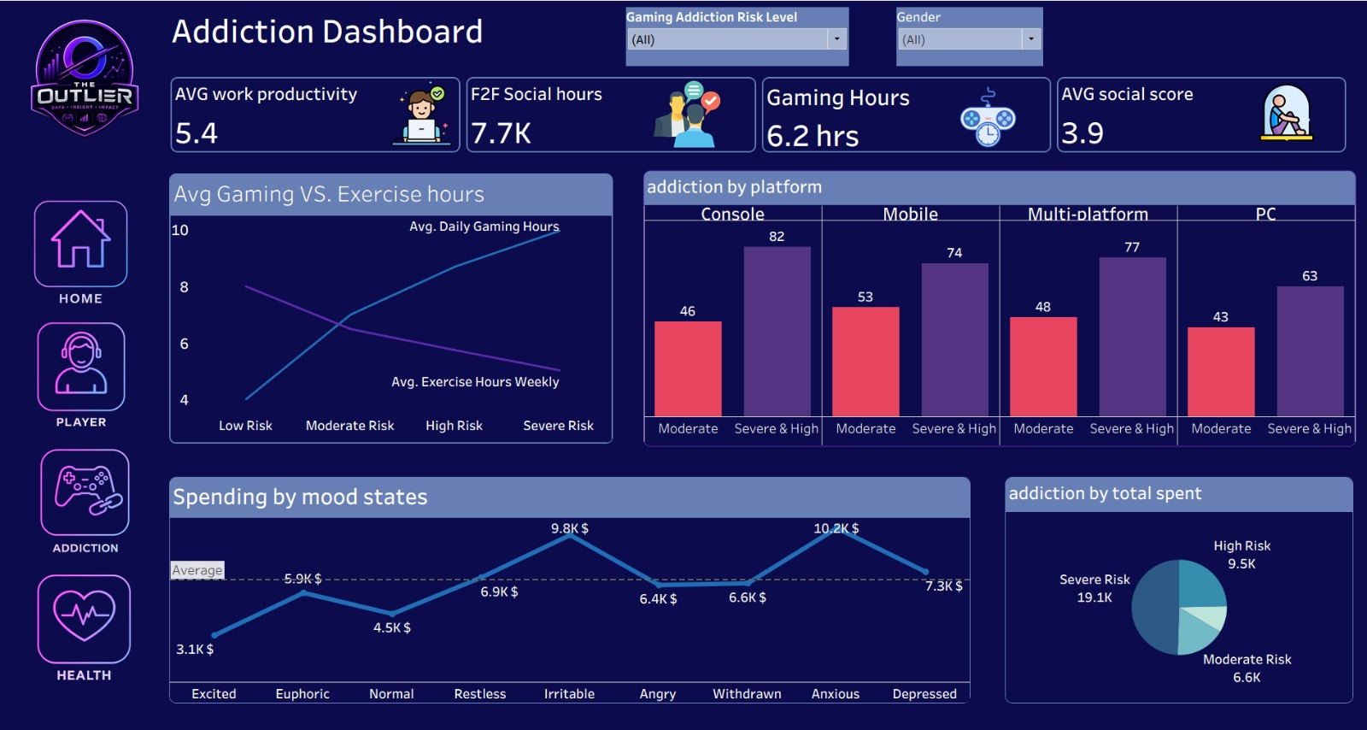
Tableau Dashboard
This dashboard focuses on gaming addiction and its impact on players' behavior. It measures addiction risk levels, social interaction, spending habits, and shows how increased addiction is associated with more gaming hours and less physical activity.

Slide 43
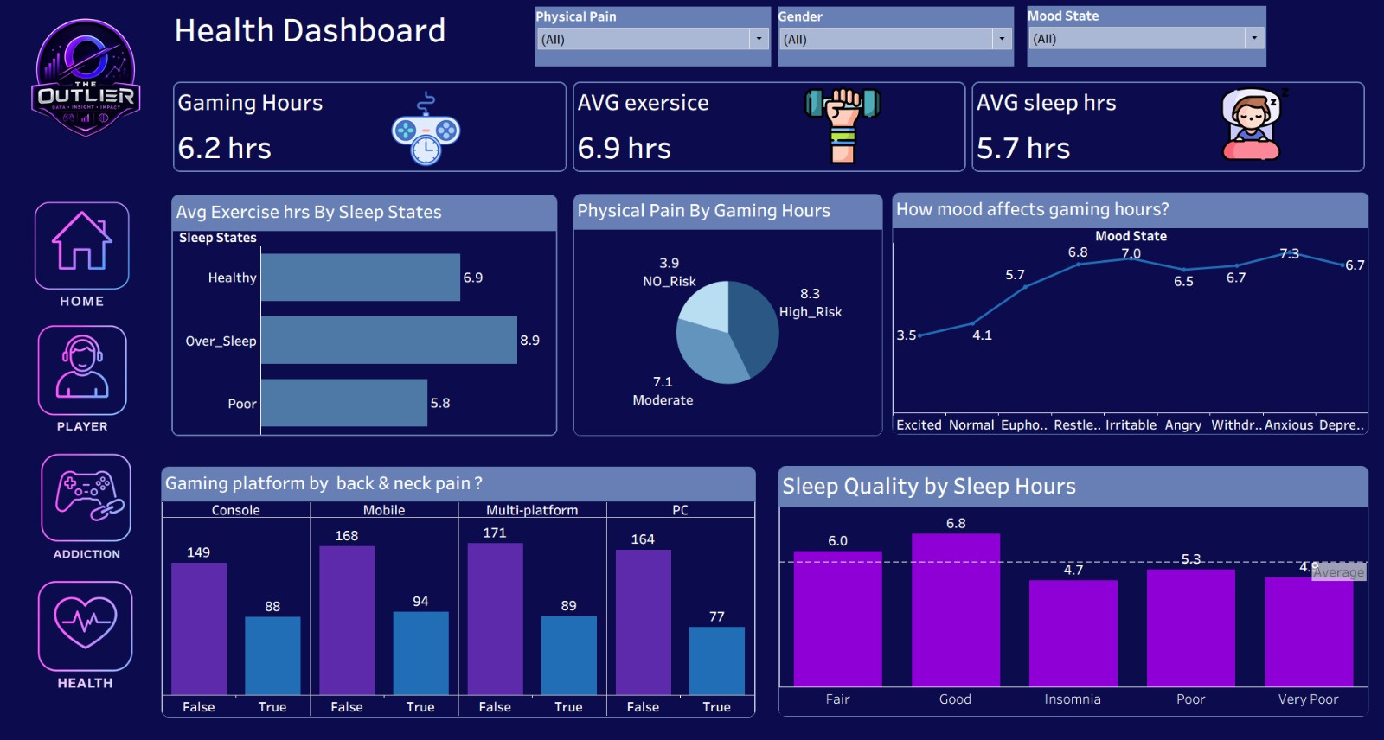
Tableau Dashboard
This dashboard analyzes the physical and mental health effects of gaming. It examines sleep quality, exercise habits, mood states, physical pain, and highlights the health risks associated with excessive gaming and prolonged playing sessions.

Slide 44
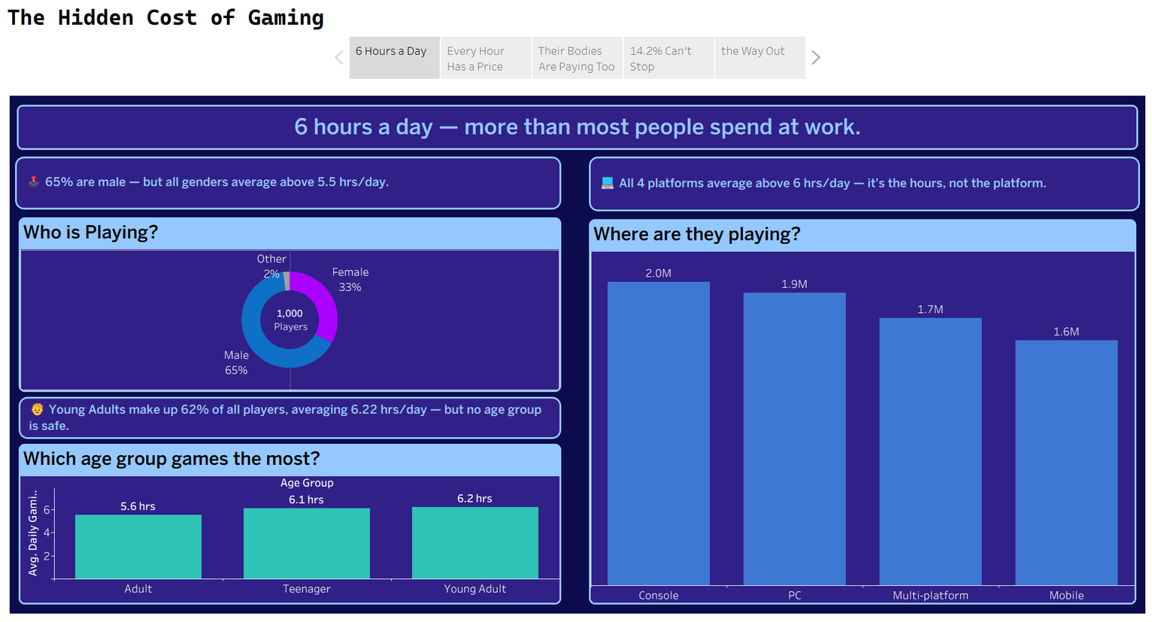
Tableau Story
We start by meeting the players. Who they are, how old, and how many hours they give to gaming every day

Slide 45
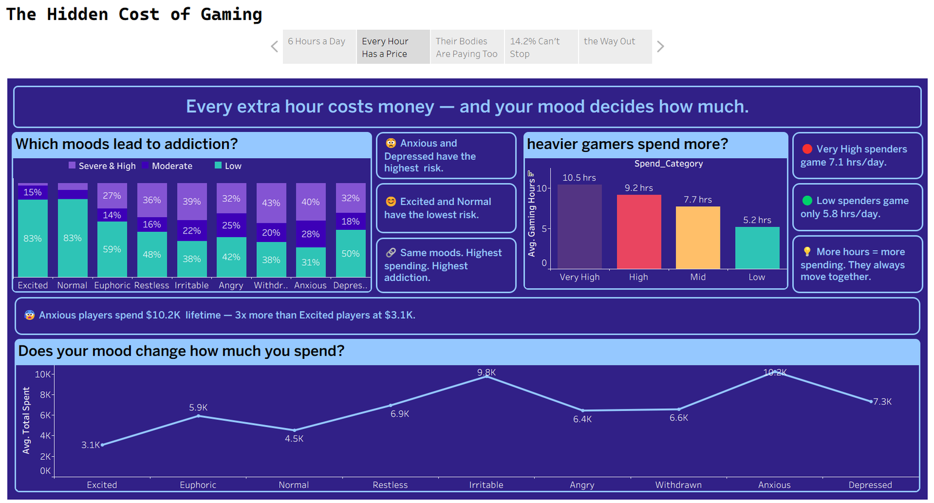
Tableau Story
We follow the money. Every extra hour spent gaming comes with a financial price — and your mood decides how high that price gets.

Slide 46
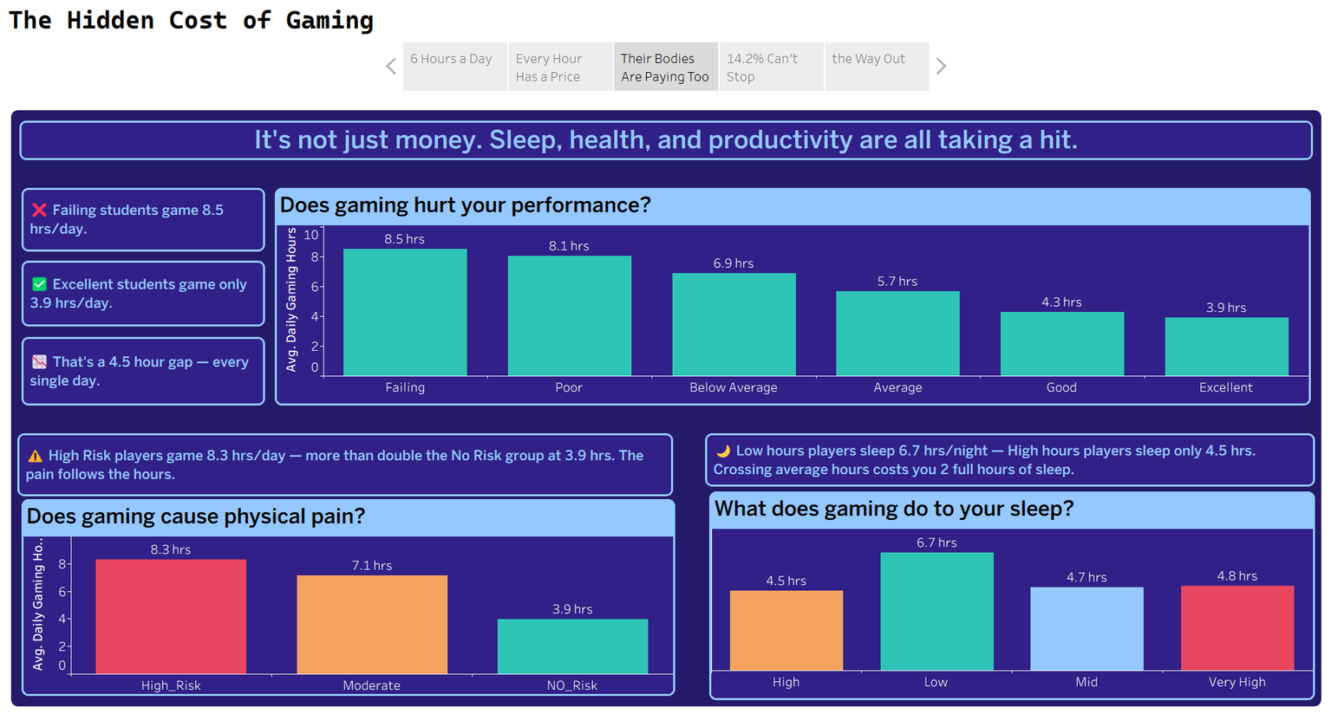
Tableau Story
We look at the body. Gaming doesn't just cost time and money — it takes sleep, physical health, and academic performance with it.

Slide 47
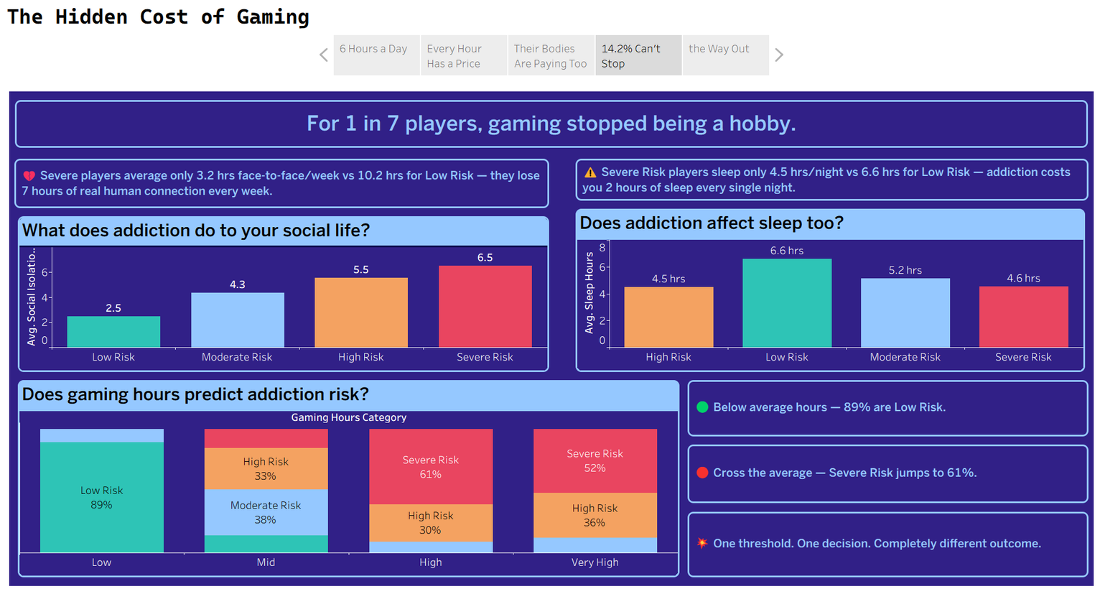
Tableau Story
We reach the breaking point. For 1 in 7 players, gaming is no longer a choice — and the data shows exactly what that looks like.

Slide 48
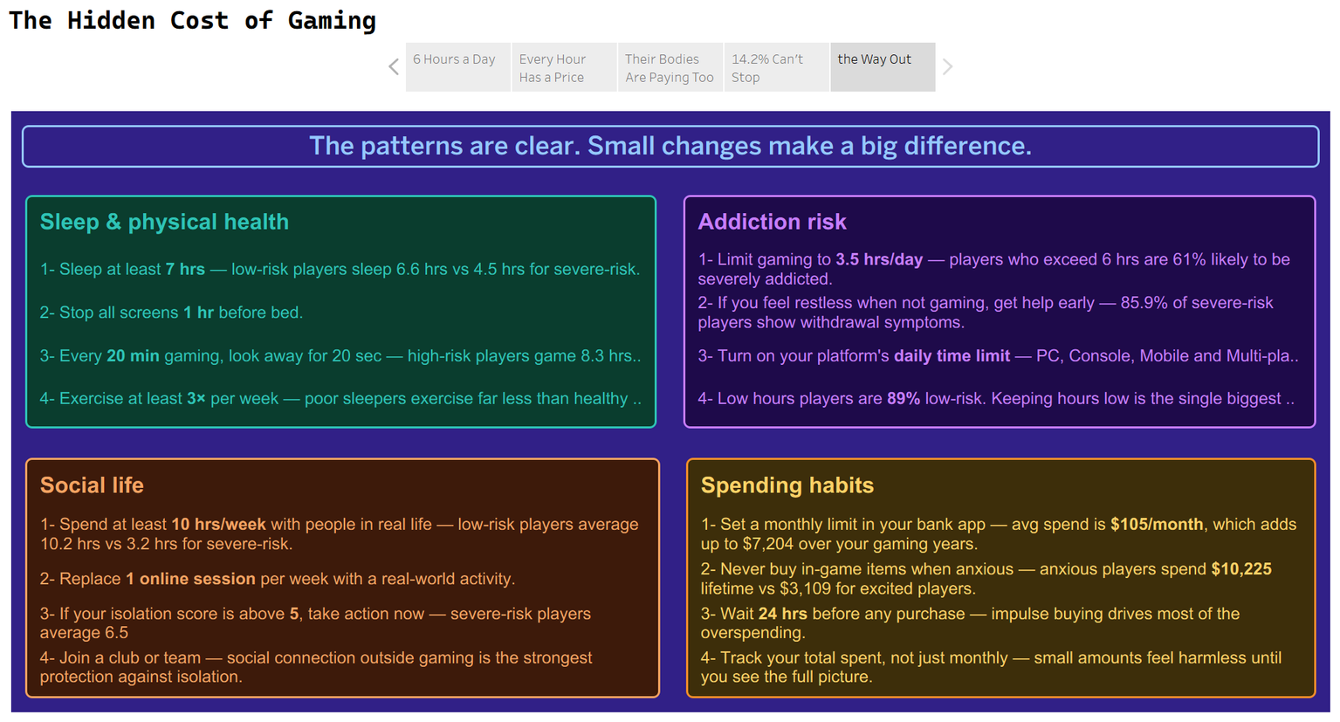
Tableau Story
Point 5 — We end with the way out. The same data that revealed the problem gives us 4 clear, number-backed steps to fix it.

Slide 49

Top 6 Key Insights
63% of players are Young Adults, making them the most affected age group.
Higher addiction levels lead to more gaming and less exercise.
Severe addiction has the highest spending ($19,139).
Anxious players spend the most on games ($10,226).
75% of players face moderate to high physical health risks.
Mobile and Multi-platform gamers report the most back and neck pain.

Slide 50
Power BI

Slide 51
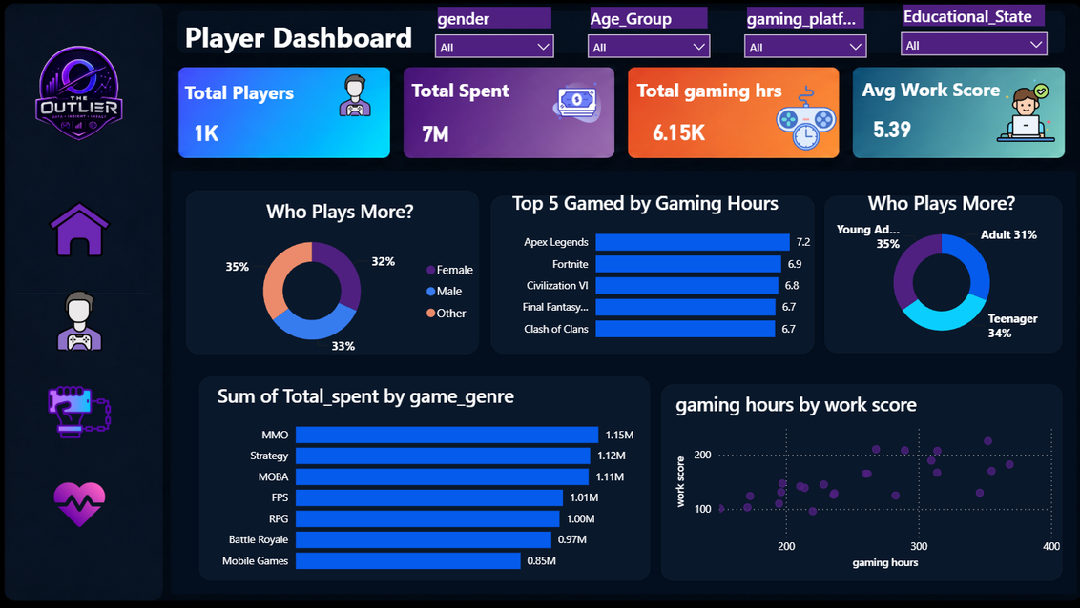

Power BI Dashboard
We used Power BI to transform the processed data into an interactive dashboard that simplifies data exploration and supports decision-making through clear visualizations and business insights.

Slide 52
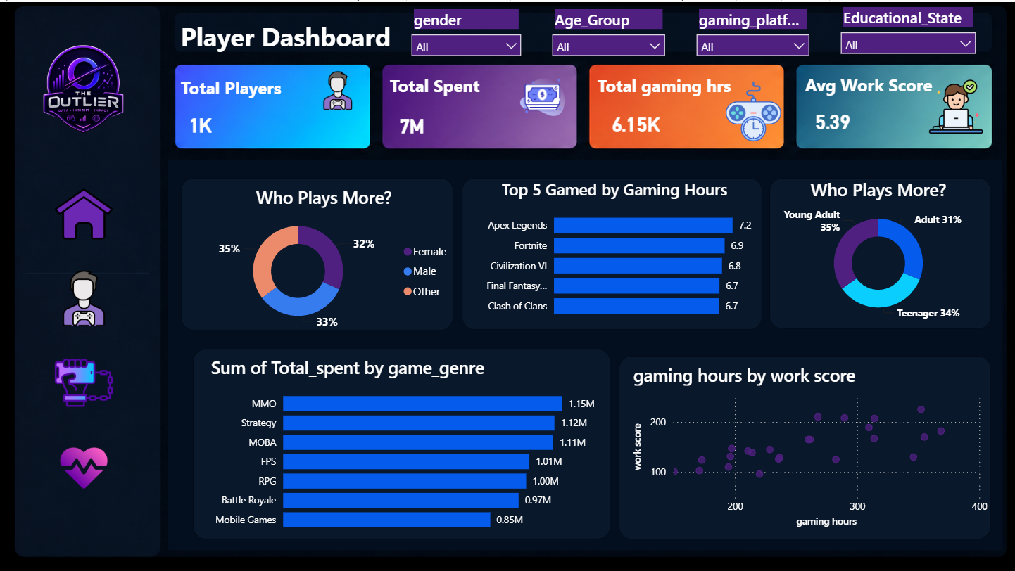

Slide 53

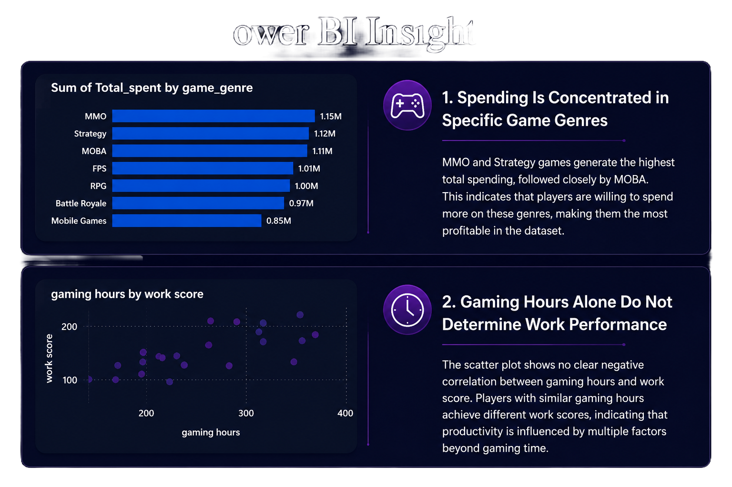
Power BI Insights

Slide 54
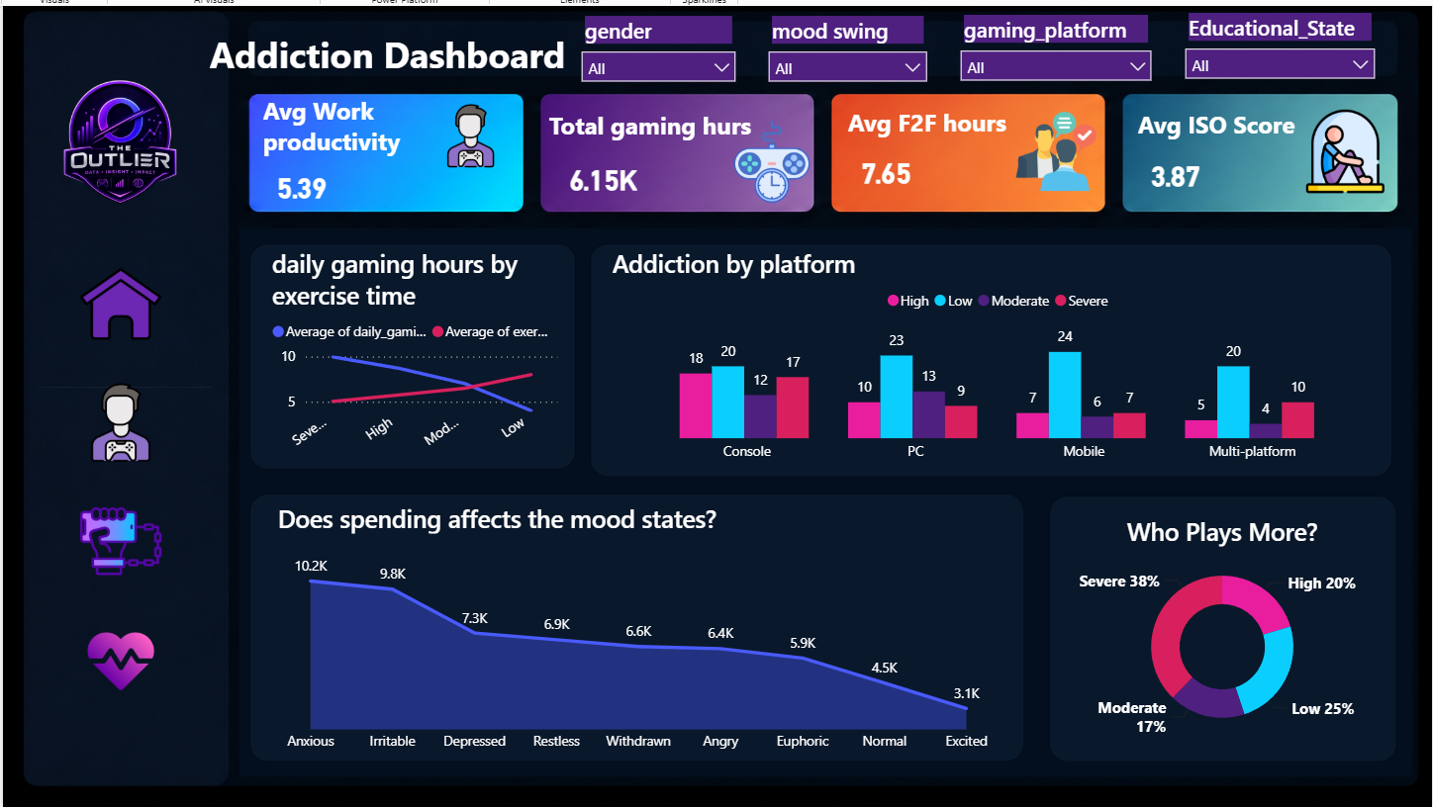

Slide 55
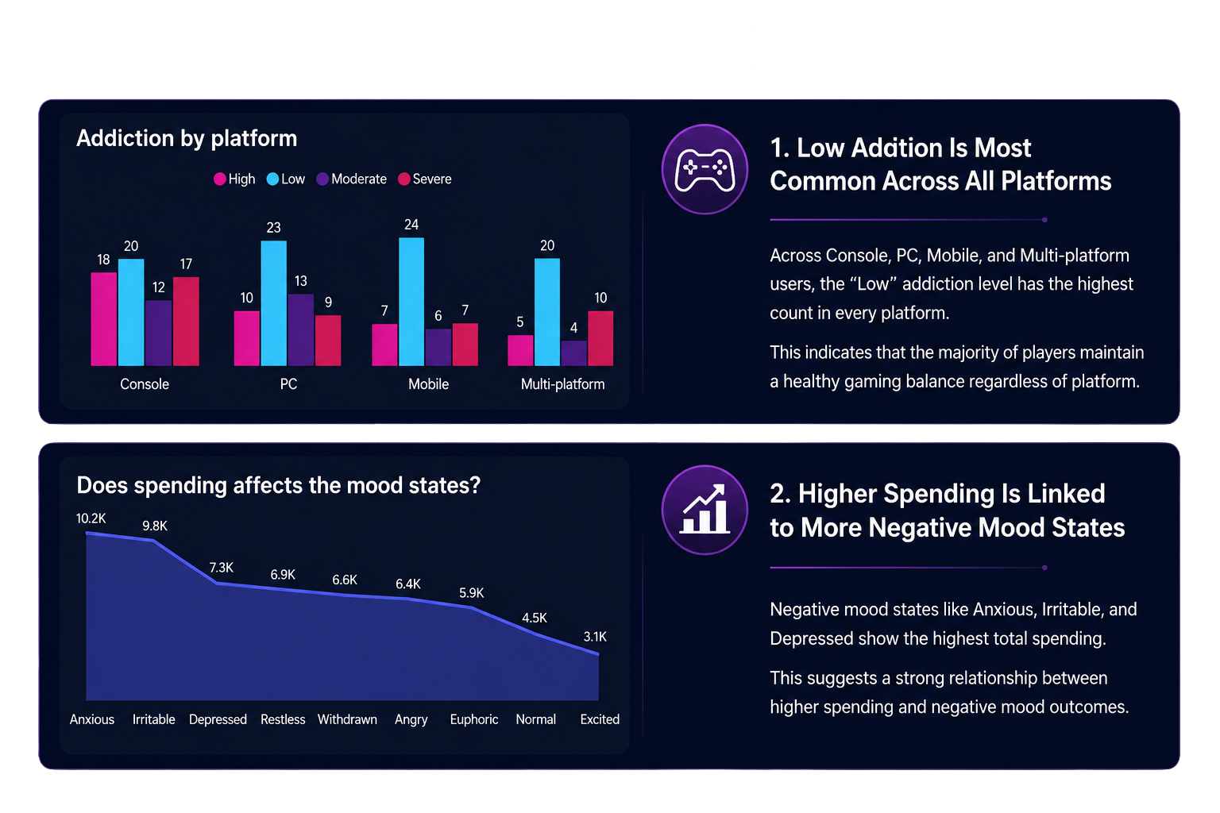
Power BI Insights

Slide 56
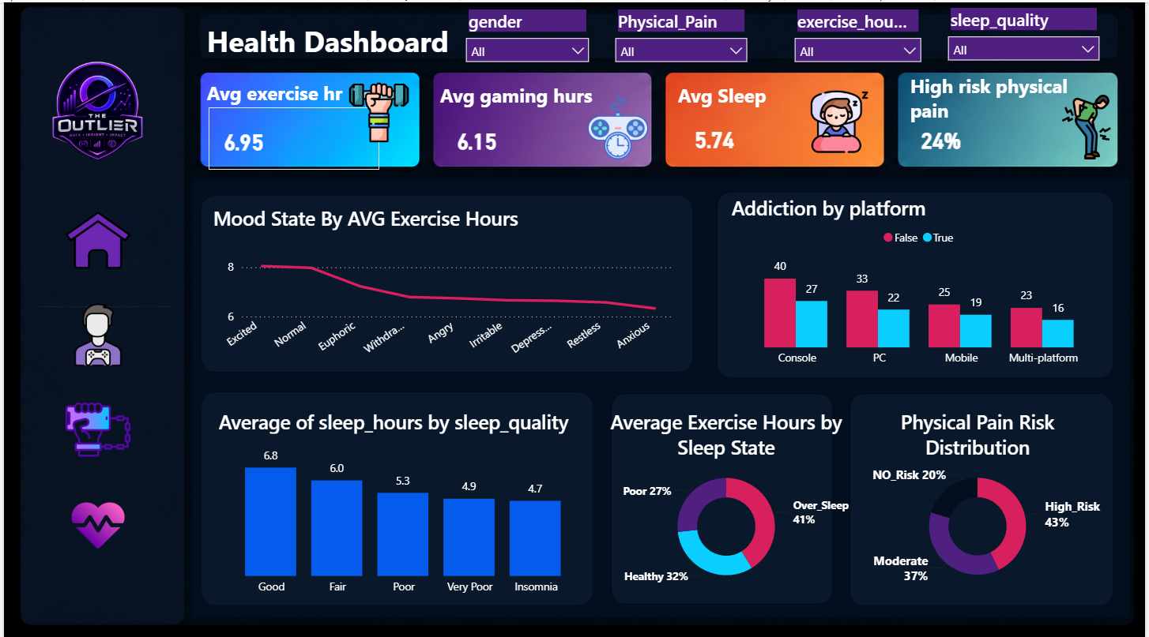

Slide 57
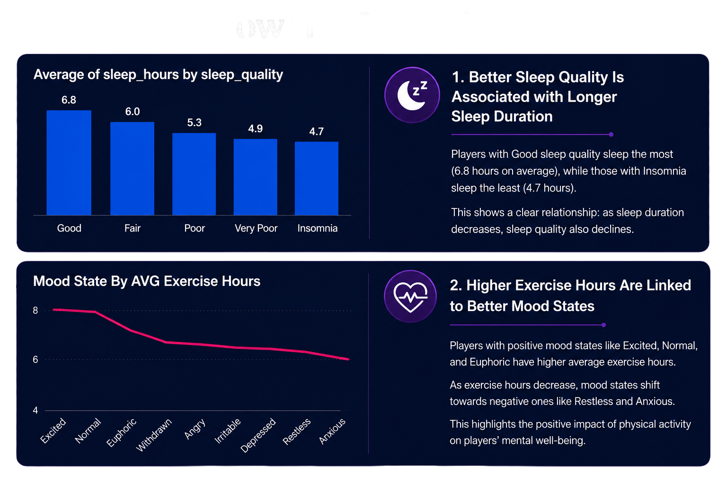
Power BI Insights

Slide 58
Final Recommendations
🎮 Balance Gaming Hours
🌙 Improve Sleep Quality
🏃 Increase Physical Activity
💰 Monitor Spending & Addiction

Slide 59


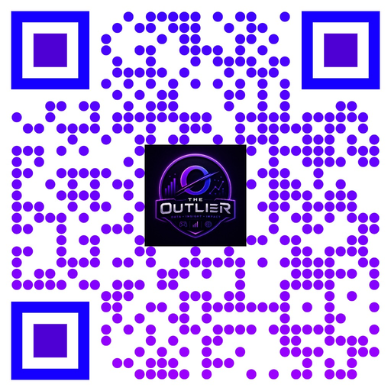

Thank You
LinkedIn
Github

